Slide 1
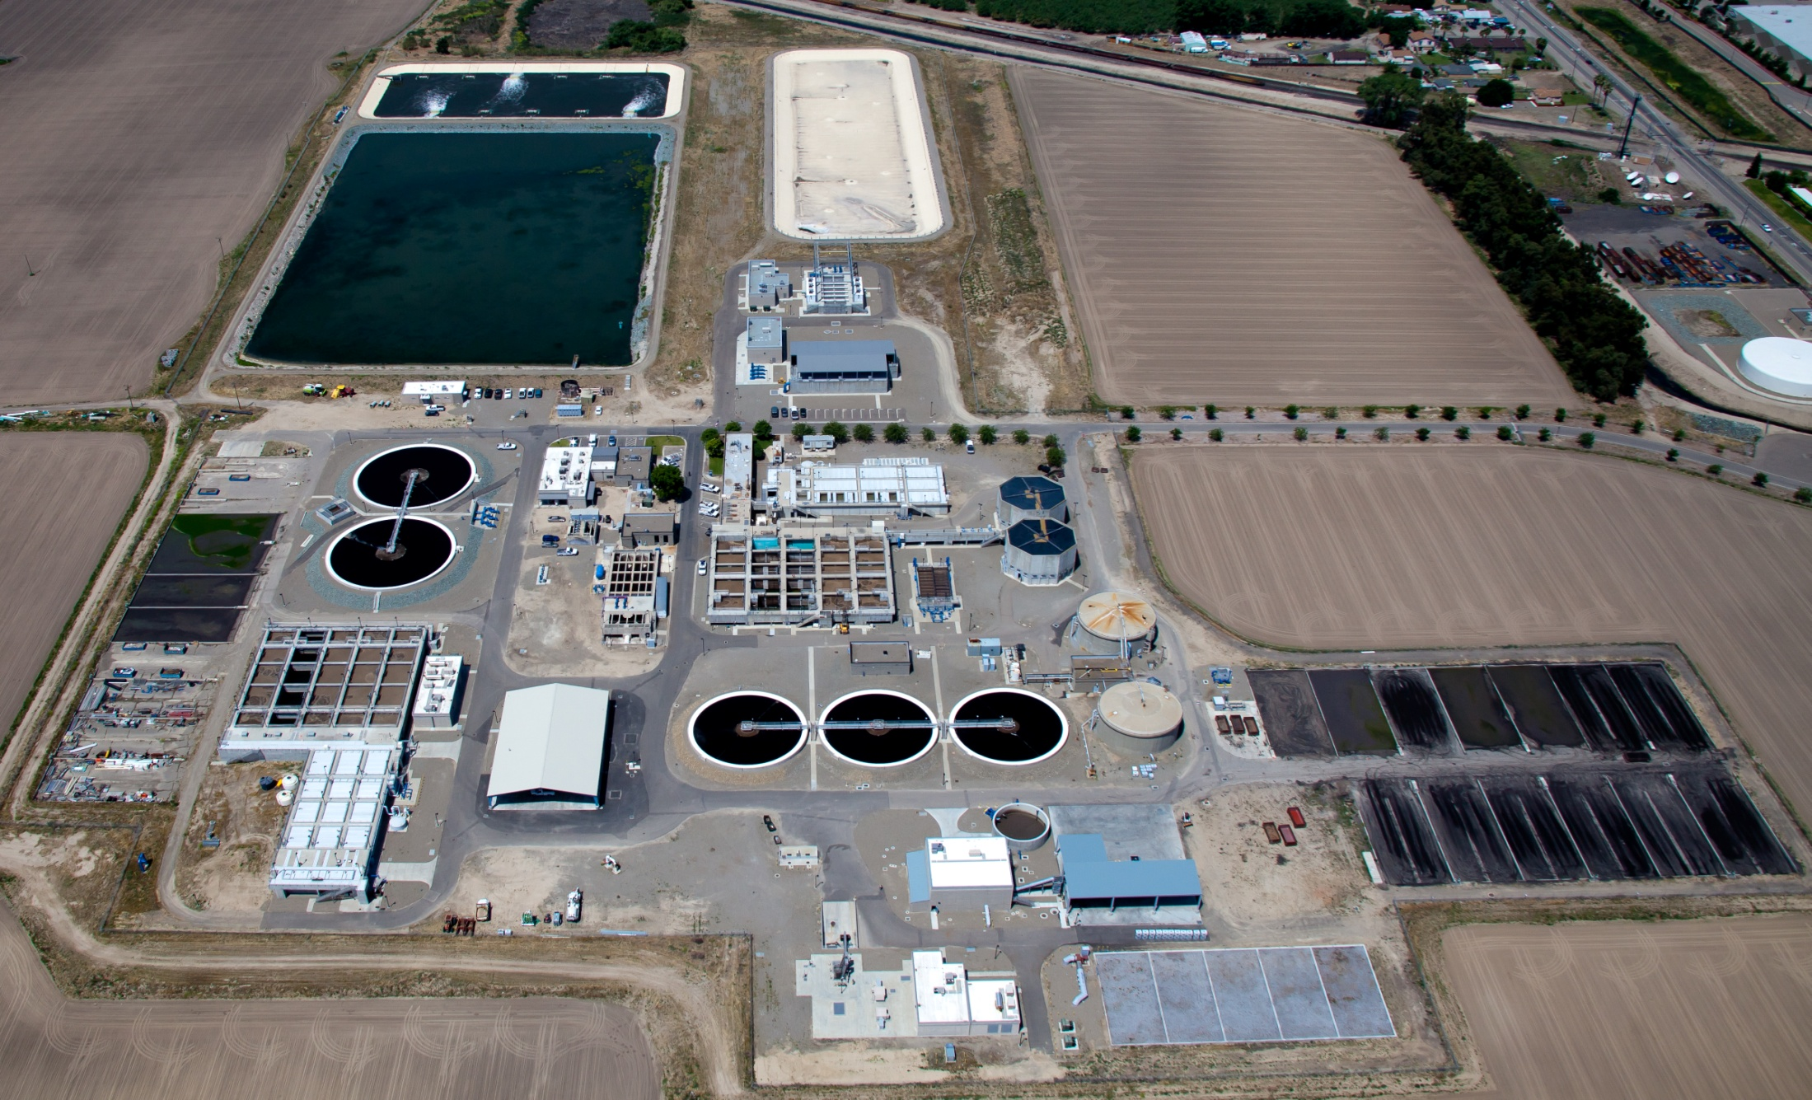
City of Manteca
Wastewater Treatment
Capacity Update May 2013

Slide 2
Historical WQCF Capacity

Slide 8
WQCF EXPANSION PLANNING

Slide 9
Questions
Thank You

