Slide 1

Temporary and Portable Signage Workshop.
City of Manteca
Community Development Department
Planning Commission Workshop
March 27, 2012

Slide 2
Background:
The Temporary and Portable Sign Committee:
Appointed by the Mayor and City Council to investigate a request of a business owner to allow an “off-premise” A-Frame sign to be located on a city sidewalk to advertise a business not in the immediate area.
Committee members: Business owner Ed Fonseca, Business owner Crystal Downs, President of the Manteca Republican Women Federated Linda Silverman, & Retired Mayor and Councilman Jack Snyder.
Working with City Planning, Economic Development and Code Enforcement staff, the members of the committee collected field information; considered land use and disabled persons accessibility requirements; and reviewed current zoning regulations.
Developed standards for how these types of non-permanent signs would be allowed and regulated using examples from cities around the nation and other planning sources.
Planning staff, under City Council and Committee direction, is proposing amendments to the sign ordinance to better define temporary and portable signage as well as human signs, and to add provisions for these signs to be allowed in the public way.
City of Manteca, Planning Commission Workshop, March 27, 2012

Slide 3
Temporary Vs. Portable
Temporary Signs:
Display a commercial/promotional message, pennant, streamer, banner, or other non-permanent sign made of paper, cloth, canvas, lightweight fabric, or other non-rigid material.
Temporary signs are allowed in the City of Manteca to be displayed for a short period of time to advertise a special event such as a grand opening, or special sale.
Temporary Signs require approval of a temporary sign permit that can be obtained “over the counter” for $10 and are good for 30-days every 3 months.
Portable Signs:
New to the Sign Ordinance in order to differentiate between temporary signs that are limited to 30-days and those that will be displayed more regularly.
Portable signs are being defined as A-Frames, Flags, and Human Signs that serve a similar purpose to Temporary Signs but are typically smaller and limited in location.
Portable Signs will need approval of a portable sign permit that requires more stringent review and approval processing. Including review of location and proof of insurance due to location on City Property.
City of Manteca, Planning Commission Workshop, March 27, 2012

Slide 4
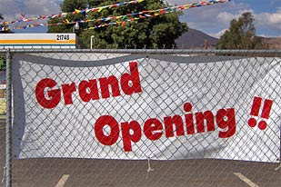

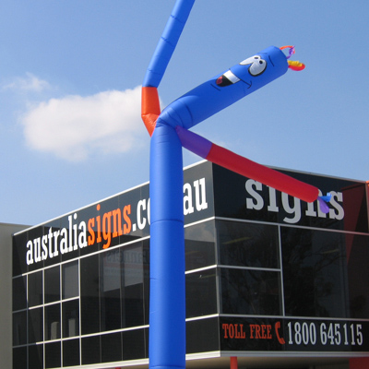

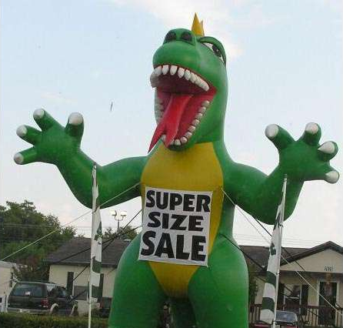
Temporary Signs
Temporary Signs like these examples are allowed because they go away after no more than a month
City of Manteca, Planning Commission Workshop, March 27, 2012

Slide 5
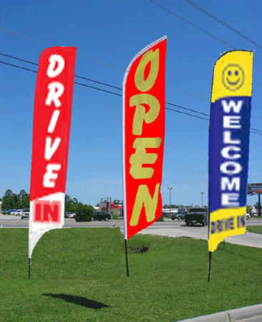
Portable Signs
Flag Signs:
Existing Sign Code:
No allowance for Flags. (Technically illegal)
Proposed Sign Code:
Allowed on the parcel or sidewalk adjacent to the business. IF
Provides 4-feet of clear passage on the sidewalk. AND
Does not obstruct opening car doors. AND
Does not block visibility at driveways or intersections.
Requires approval of portable sign permit.
Two flags per 50-feet of business frontage.
No bigger than 15 sq. ft.
No taller than 15-feet.
Non-illuminated.
NOT permitted within multi-tenant centers.
City of Manteca, Planning Commission Workshop, March 27, 2012

Slide 6
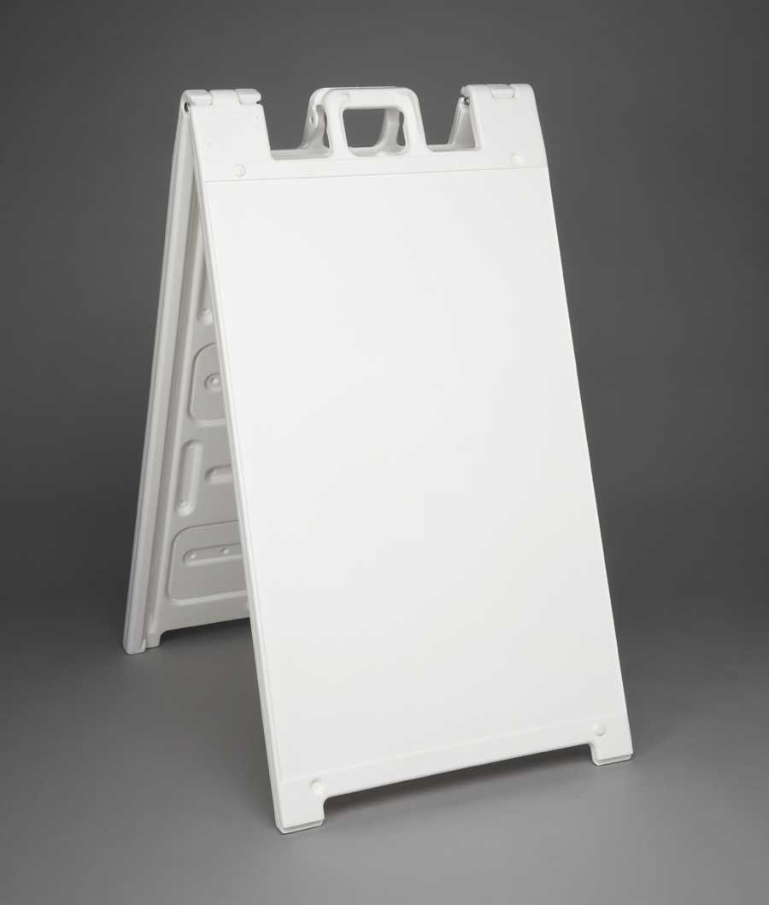
Portable Signs
A-Frame Sign:
Existing Sign Code:
Allowance for one a-frame sign per business located on the property.
Proposed Sign Code:
Allowed on the parcel or sidewalk adjacent to the business. IF
Provides 4-feet of clear passage on the sidewalk. AND
Does not obstruct opening car doors. AND
Does not block visibility at driveways or intersections.
Requires approval of portable sign permit.
One A-Frame sign per 50-feet of business frontage.
No bigger than 12 sq. ft.
No taller than 4-feet.
Non-illuminated.
3-foot wide by 4-foot tall. 12 sq. ft. total.
NOT permitted within multi-tenant centers.
City of Manteca, Planning Commission Workshop, March 27, 2012

Slide 7

Portable Signs
Human Signs:
Existing Sign Code:
No allowance for Human Signs. (Technically illegal)
Proposed Sign Code:
Allowed on site or sidewalk adjacent to the business.
Requires approval of portable sign permit.
One per business location.
Sign no bigger than 12 sq. ft.
Shall not interfere with use of the sidewalk or block visibility at an intersection.
Not allowed to be lit, animated, flashing, blinking, etc. and not allowed to generate any noise that would disrupt traffic or endanger pedestrians.
City of Manteca, Planning Commission Workshop, March 27, 2012

Slide 8
POINTS OF DISCUSSION
Recommend Enforcement of Existing Code.
Amend Existing Code as Recommended by the Temporary & Portable Sign Committee.
Direct Staff to Amend Recommendations of Committee and bring back for review at workshop OR public hearing.
City of Manteca, Planning Commission Workshop, March 27, 2012

