Slide 1
Capital Improvement Program (CIP) Training
Finance Department

Slide 2
Capital Improvement Program (cip)
Five-year plan of capital improvement needs
Acquisition, expansion or rehabilitation of land facilities, buildings, major equipment and other infrastructure

Slide 3
Qualifications For A CIP
All projects exceeding $25,000
City Infrastructure exceeding $100,000 for Public Works
The purchase of equipment, with a purchase value of $25,000 or greater
Minor CIP
One time purchase of equipment/supply exceeding $5,000

Slide 4
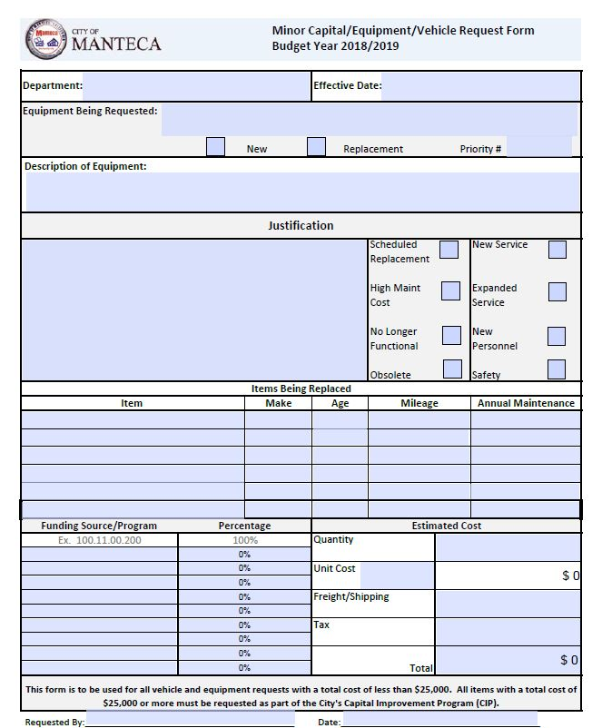

Slide 5
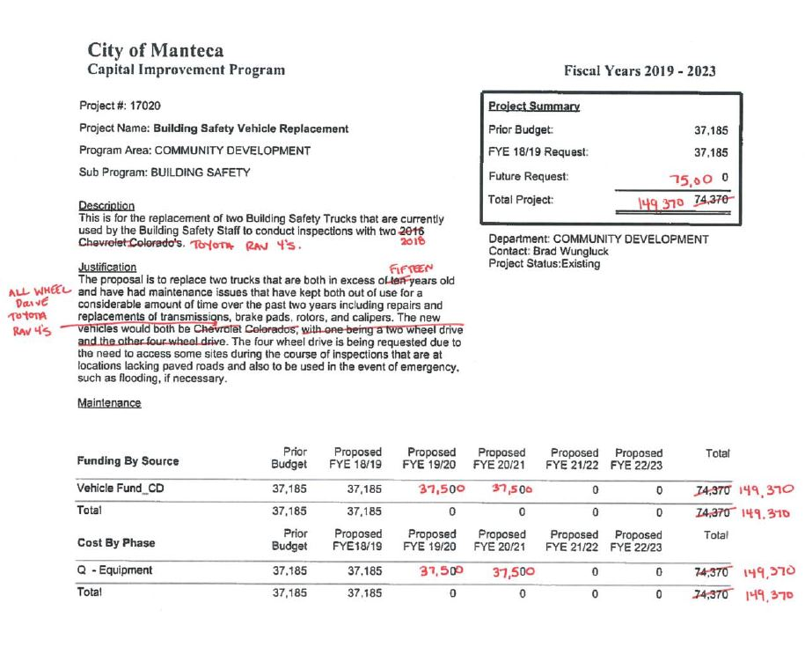
CIP Markups
The purpose is to notify Finance if an existing project needs to be updated.
Finance will make the changes in the CIP software.
To ensure all information is accurate, a checklist will now be included with each sheet.

Slide 6
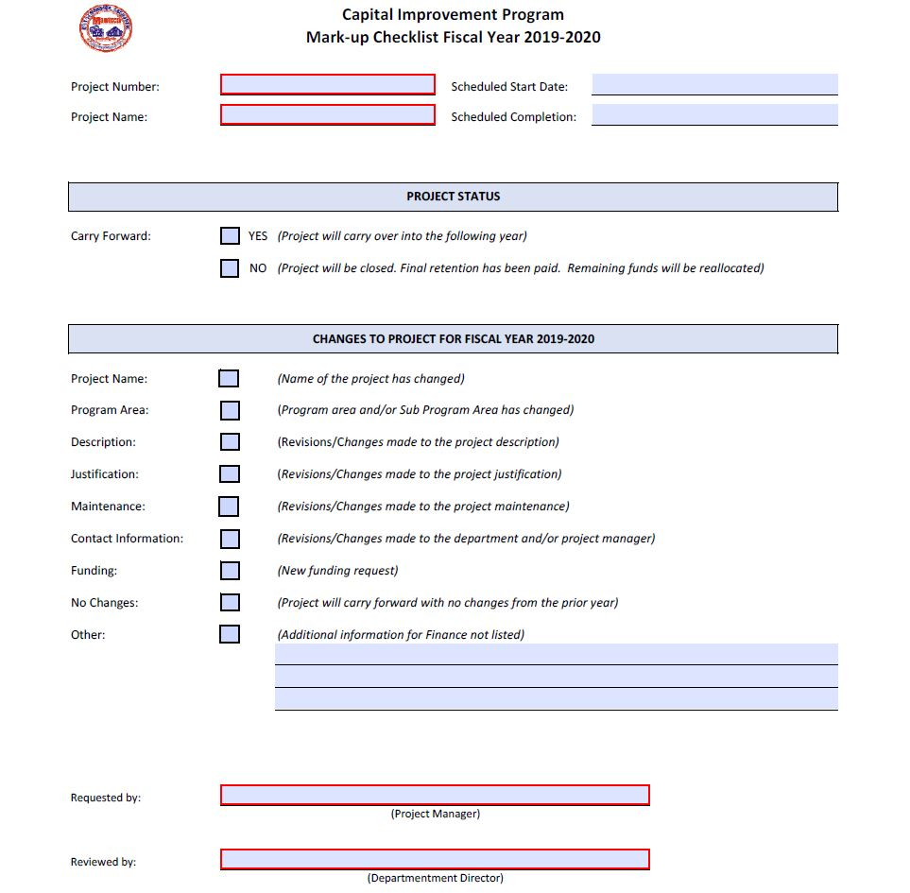

Slide 7
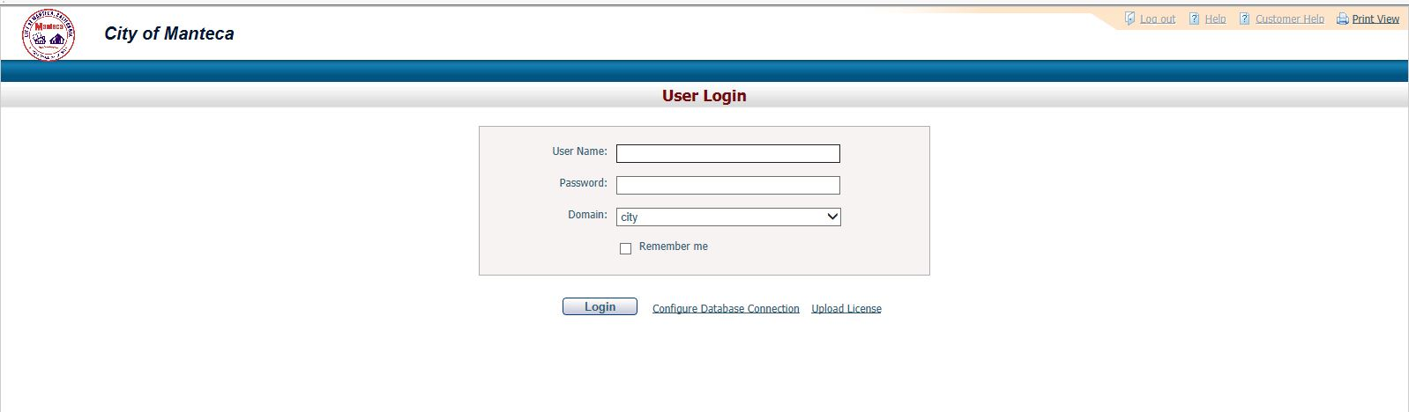
CIP ACE

Slide 8
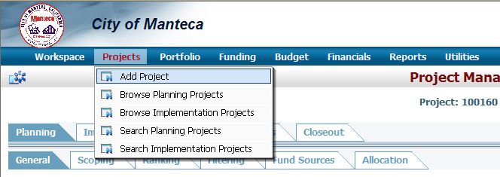

Slide 9
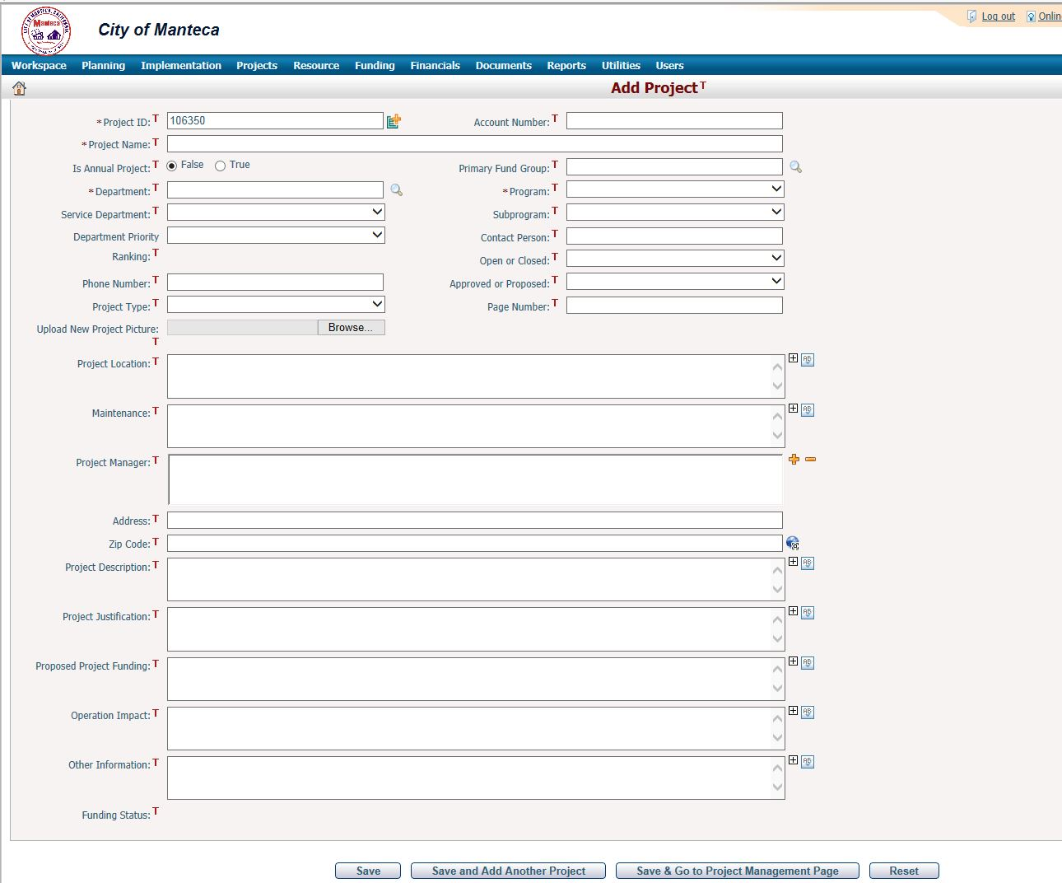

Slide 10
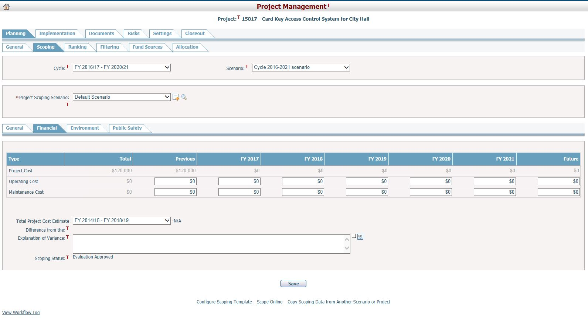

Slide 11
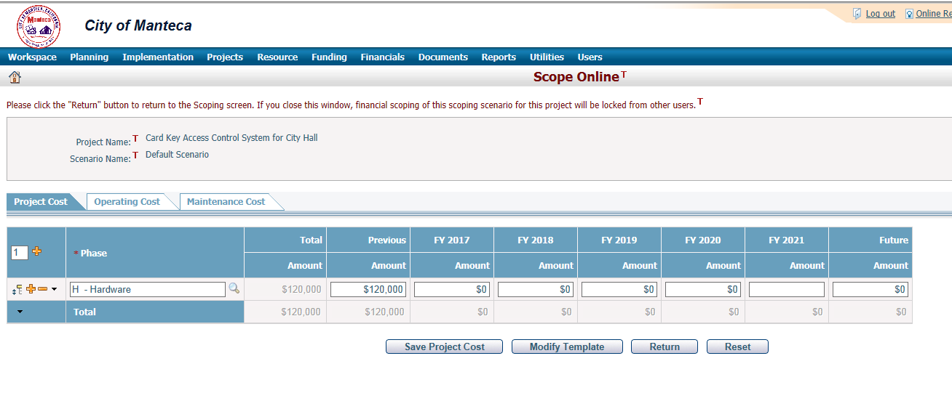

Slide 12
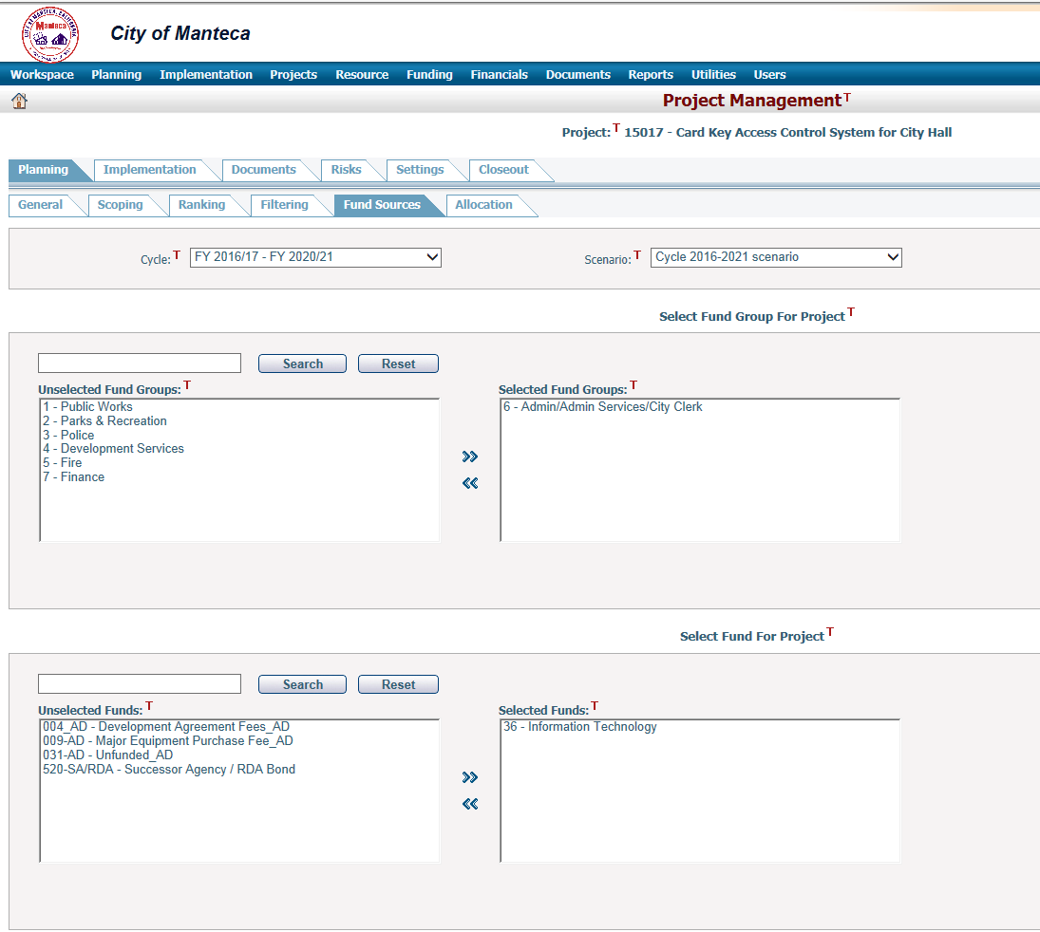

Slide 13
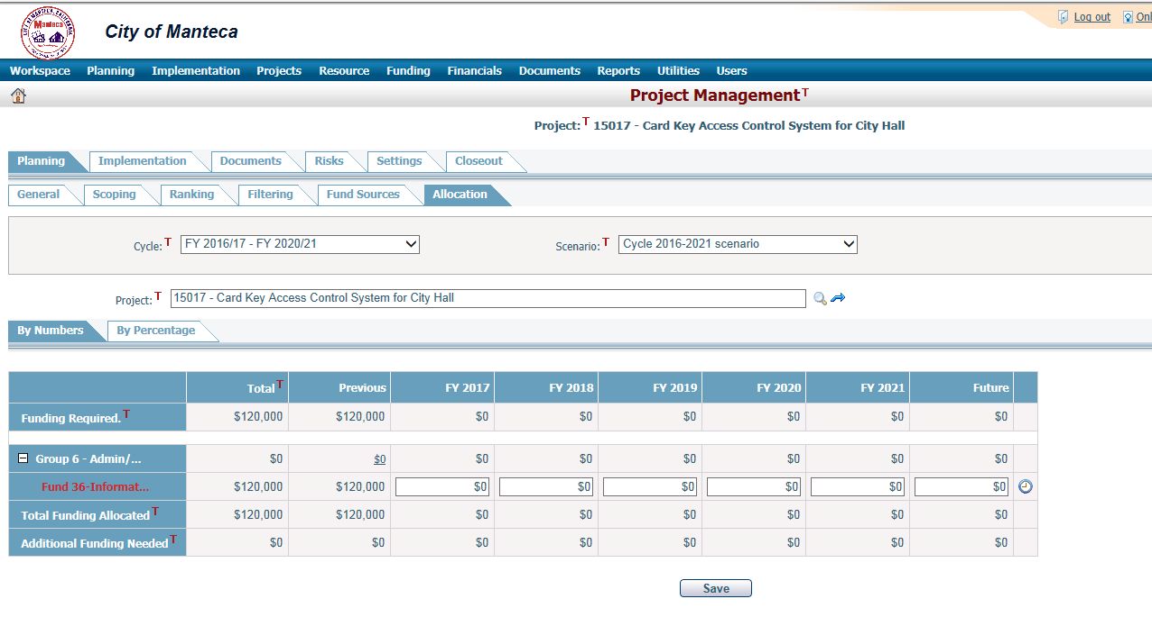

Slide 14
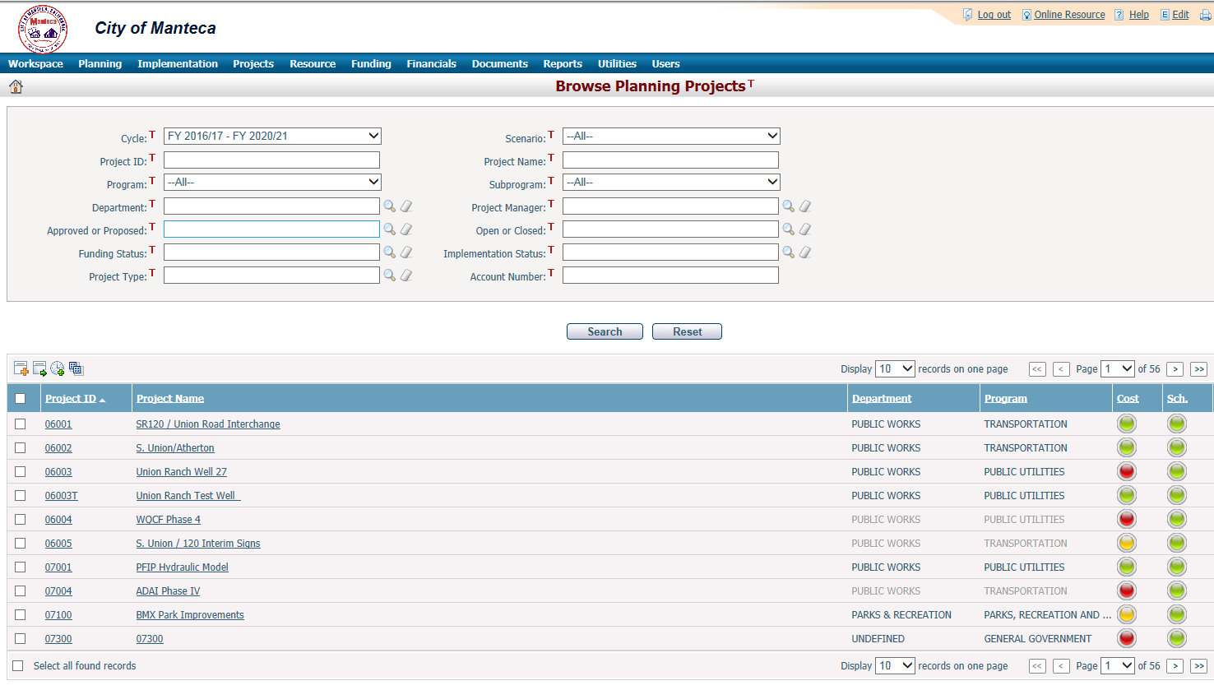

Slide 15
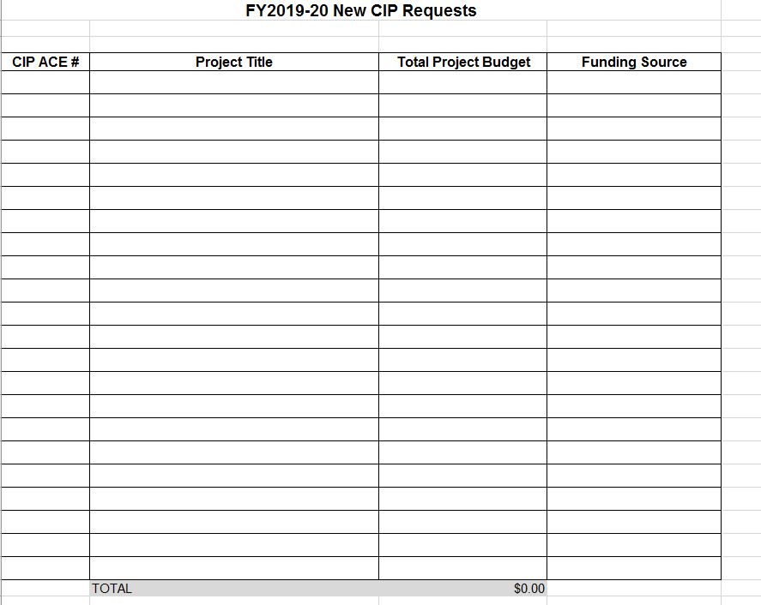

Slide 16

Funding
Need to have funding source secured
CIP Budget authorizes funding
Need to follow Purchasing Policy
Council Approval for additional funds

Slide 17
Final Thoughts…
Adopted CIP and account numbers will be sent
Finance will clean up old projects
Budget calendar will be sent out
CIP Markups DUE February 28, 2019 (NO Exceptions)
Finance is here to help

Slide 18
Any Questions?
FINANCE CONTACTS:
Leila Menor x 8776
Sara Cowell x 8785

