Slide 1
BUDGET FY 2020-21

Slide 2
The Basics - Revenues
Taxes
Property , Sales, Assessment, Transient Occupancy
State Revenue Sources
VLF, Gas Tax
Grants
CDBG, Supplemental Law Enforcement
Fees
Franchise, Planning, Connection, Utility service, Development Impact, Park
Licenses/permits
Fines
Penalties
Interest

Slide 3
The Basics - Revenues
Taxes
Increase or new general tax requires majority voter approval
Special tax requires 2/3
May be reduced or repealed by initiative
User Fee/Rate
Can not exceed the cost of providing service
Development Impact
Required to serve new development only
Property related
Requires a majority vote of the property owners
May be a written protest
Property tax limited by Prop 13

Slide 4
The Basics - Revenues
General Fund
Unrestricted revenues
Not required to be accounted for in a separate fund
Still may be designated for a specific purpose
Special Revenue Funds
Revenues are legally restricted to a specific purpose
City has 13 special revenue funds
CDBG, Park Grants, Federal Transit, Recreation, Assessment Districts
Property tax, sales tax, business license, transient occupancy

Slide 5
The Basics - Revenues
Capital Improvement Funds
Revenues are collected for the acquisition and construction of capital facilities
City has 11 capital funds
Gas Tax, Measure K, Park Fee, PFIP Drainage
Enterprise Funds
Account for City operations financed and operated in manner similar to private business
User charges
City has 8 enterprise funds: Water, Sewer, Solid Waste, Golf
Internal Service Funds
Contributions from other funds

Slide 6
The Basics - Expenditures
Four Categories
Salaries and Benefits
Material and supplies
Capital
Includes both major and minor capital outlay, capital improvement projects
Debt Service

Slide 7
The Basics - Expenditures
Department Responsibility
Overtime
Part Time/Temporary/Seasonal
Requests for New Personnel
Submitted by department
Must include salary calculator and position justification forms
Salaries calculated by department using the Salary Matrix
includes salary, benefits, recruitment and equipment costs

Slide 8
The Basics - Expenditures
Budget Office
Salaries and benefits (excluding part time and overtime)
Contributions to internal service funds
Support charges
Departments
Part time and overtime, professional services, supplies, training, vehicle maintenance, building maintenance
Should be looking at both trend analysis and zero based budgeting

Slide 9
The Basics - Expenditures
Capital requests include equipment, vehicles, and improvements
Minor Capital Outlay
Threshold is $5,000 per item - if item does not meet threshold it should be classified as materials and supplies even if you are purchasing multiples of the same
Multi-year Capital Improvement Projects
Full cost should be estimated to be expended by year end with unexpended amounts to be carried over

Slide 10
The Basics - Expenditures
Budget Office will provide:
Interdepartmental loans
Transfers
Debt Service

Slide 11
The Basics – Budget as a Policy
An appropriation is the legal authorization to expend monies or incur obligations
Expenditures can not exceed appropriations
Council must authorize any additional appropriations or transfer of funds once the budget has been approved
Council must also authorize expenditures beyond the City Manager purchasing threshold, regardless of whether the funds have been appropriated
With extenuating circumstances, budget appropriations can roll into the next FY with Council authorization through the budget process

Slide 12
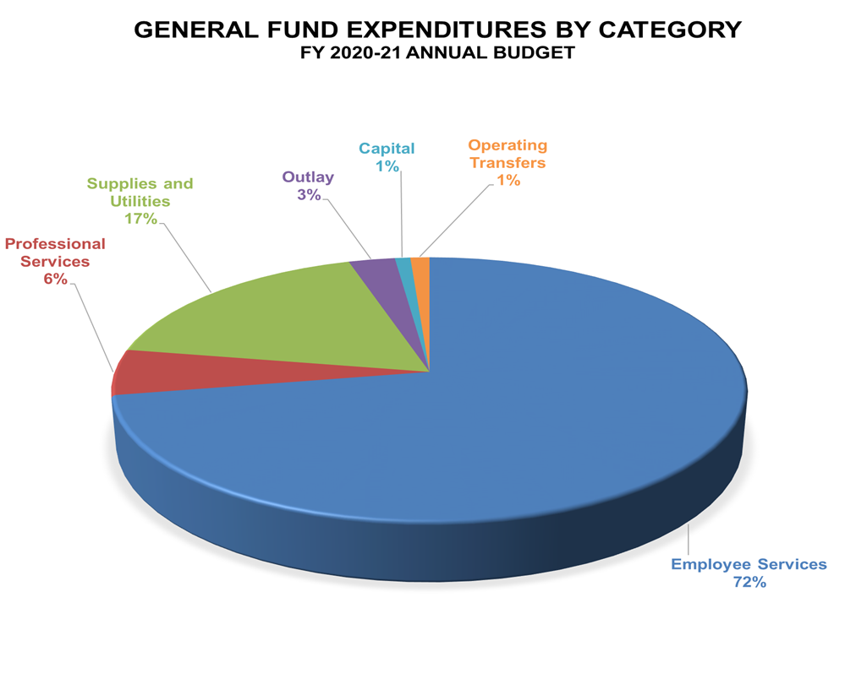
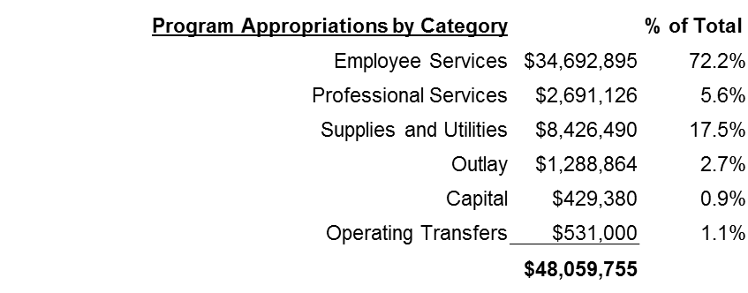
Where the Funds Go

Slide 13
The Process
Budget calendar/memo sent to department managers in early February
Departments submit personnel requests
Salary calculator with justification form provided on Sharepoint
Personnel requests are reviewed by Budget Review Team:
City Manager, Assistant to the City Manager, Deputy City Manager,
Director of Employee Services and Engagement, Budget Manager

Slide 14
The Process
Department Role:
Submit budget, personnel and CIP requests through proformas and New World budget entry
Review and provide accurate salary projections
Evaluate and revise narratives and org charts annually
Budget Office reviews all requests based on:
Department needs
Impact on operations
Rate studies
Equity study
Availability of funds
Global needs

Slide 15
The Process
Budget Office role:
May ask questions to departments regarding requests
Work with Departments to determine appropriate funding based on existing and future service levels
Assist with new fee analysis for cost recovery measures
Present new position and funding requests to Budget Review Team
City Manager and Budget Review team make final revisions to proposed budget and forward back to departments for review
Individual meetings held with departments if requested

Slide 16
The Process
Preliminary budget document is presented to the City Council for review during public study session hearings held in June
Final budget approved by Council at regularly scheduled Council Meeting

Slide 17
Budget Documents
Proposed and Final Budget Document
Reviewed by Council
Contains detailed narrative
Contains organization charts and work program narratives
General fund detailed by department

Slide 18
Next Steps for FY 2020-21
Review existing levels of service
Examine service delivery models to identify areas to improve efficiencies
Review revenue structures to ensure full cost recovery where appropriate
Review contracts for consolidation and cost-savings
Develop quarterly financial reports to assist decision-making body

Slide 19
FY 2020-21 Calendar
September
New Position Requests, CIP meetings, Budget due
October
Narratives and Org charts, CIP Review
November
City Manager budget review and approval of budget/position requests
December
Council Special Hearing

Slide 20
THANK YOU

