Slide 1
Mastering a City Council Staff Report
January 25, 2023

Slide 2

What is a staff report?
A staff report is the communication tool for the legislative body and the public.
It provides important information to allow the decision makers to set the policy direction for the City.
Part of the official legislative packet FOR.EV.ER.

Slide 3
Elements of a Staff Report
Recommendation/Title
Background
Fiscal Review
Approval Review

Slide 4
Recommendation/Title
The title is the recommended action of the City Council.
The staff recommendation should be brief.
Example:
“Adopt a resolution awarding the contract to Kimley-Horn and Associates, Inc. for Professional Engineering services to prepare a Local Road Safety Plan (LRSP) for an amount not to exceed $78,000, and authorize the City Manager to sign the agreement and associated documents.”

Slide 5
Background
You need to covey both simple and complicated matters in a succinct way.
State the facts and keep emotion out of the statements.
Summarize the issue.
Tell the story by answering the following questions:
Where/when did the issue begin?
What occurred between the beginning and the present day requiring the legislative body to make a decision?
Be specific.

Slide 6
End the Background
Lead the reader to the staff recommendation.
State why the action is important.
Keep the conclusion brief –a few sentences.
Example:
“based on qualifications and scope of work, Kimley-Horn and Associates, Inc. (consultant) was selected as the most responsive and best-qualified firm to meet the specific goals of said project. Staff has established a Scope of Services with consultant.”

Slide 7

Fiscal Review
Provide a thorough analysis of the costs and/or savings.
State the fund(s) that are impacted by this action.
If needed use tables in addition to written statements to describe the fiscal impact of the action.
Budget appropriation/transfers.
Does your recommended action match your title?
If there is no fiscal impact be sure to include this in the staff report:
“There is no fiscal impact.”

Slide 8
Approval Process (Finishing the Process)
Do a final review of your report.
Make sure all necessary attachments are included and labeled properly.
Always double check the attachments and make sure they are referenced in the staff report correctly.
You are ready to start the approval process!
Notification emails regarding changes
Track changes are used by all approvers.

Slide 9

Approval Review
What approvers are looking for

Slide 10
Fiscal Review Approval Review
Overall Staff Report:
Does the staff report clearly convey the intended message?
Is there sufficient background information?
What is missing that could cause a concern with the auditors?
Would the overall report pass auditor scrutiny?
Would the overall report pass the headline test?
Fiscal Impact:
Is the fiscal impact section complete and accurate?
Does the fiscal impact match all the supporting documents?
Is a CIP affected and what is the effect?
Is there sufficient budget for the fiscal impact?

Slide 11
Fiscal Review Approval Review (continued)
Resolution
Does the resolution do what is intended?
Does the resolution authorize an appropriation (if needed)?
Does the resolution amend the Capital Improvement Program (if needed)
Is the resolution consistent with the staff report and supporting documentation?
Attachments
Do the attachment match the staff report and provide sufficient backup?
Are any relevant attachment missing that would provide clarity and support?

Slide 12

Environmental Analysis
This section describes how this issue complies with the California Environmental Quality Act (CEQA) and other environmental requirements.
This section is not needed for all items.
Title requirements for CEQA exempt projects.
Resolutions… FINDINGS, FINDINGS, FINDINGS!!
Courts cannot impose findings where they are not set out by the Legislative Body. This is a way to save projects that are challenged under CEQA.

Slide 13

Legal Review
Consistency (numbers, dates, and $).
No cut and paste without checking the nitty gritty.
Does the staff report answer all questions or lead to more questions?
Make sure the Resolution and any subsequent documents (i.e., contract, staff, etc…) are *nsync.
Legal looks for legal…but distractions can take away from that
Is a resolution needed?
There may be occasions when a resolution is requested/still required for an item that may typically not have required one previously – including, but not limited to a grant condition, audit, and/or request by another public agency. Please contact the
City Attorney’s Office for assistance if there are questions.

Slide 14
Legislative Review
Staff Report:
Listed properly on the agenda.
Action in the Title
Adopt a resolution
Waive the first reading
Authorize City Manger to Sign
Does the staff report make sense to the general public.
Correct template, spelling, grammar, punctuation, formatting etc.
Is it a complete report.
Attachments are listed accurately on the report and match the action.

Slide 15
Legislative Review
General Attachments:
Match the action.
Listed in same order as the action and match the way they are listed in the report.
Correct attachment headers on each attachment.
Correct attachments to support the staff report.
Not to many attachments attached.
Resolutions/ Ordinances:
Title matches your action.
Placed on the correct template and all sections are completed.
Redline
Confirming Public Notice
Makes sense to the general public.
Action clearly stated in the now therefore section.

Slide 16

City Manager Review
Always print out final approved agenda report and save that as your “template” – remember - not every report fits all.
Always be available when City Manager’s Office call for clarification on agenda/approval days.
Avoid Jasso saying “I’m about to pull this from the agenda.” ☺
City Manager’s Office has final approval/say on all agenda items.

Slide 17
Presentation
First, determine the type of presentation that is needed for your item:
Consent calendar, discussion item or public hearing.
Oral presentation only or oral presentation with a PowerPoint.
Prepare for the presentation.
Do not plan on reading the staff report for your presentation.
Prepare a script – an abbreviated version of the report.
Restate recommendation for Discussion and Public Hearing Presentations.

Slide 18
Presentation (continued)
The PowerPoint:
Use City of Manteca Template
located on the Intranet under “Agenda Management”
Have your PPT be consistent the same fonts, colors, etc., throughout the presentation.
Tables/Graphics - make sure the font size is large enough to read.
Minimal text - explain concepts in the oral presentation.
Align your objects and bullet points for a clean look.

Slide 19

Presentation (continued)
Practice the presentation.
Practice, practice, practice!!
Practice in the room where you are going to give your presentation.
Practice out loud.
Look up at your audience and do not just look at your paper.
Smile!
Be aware of your body language & tone of voice.
Anticipate and prepare to answer questions.

Slide 20
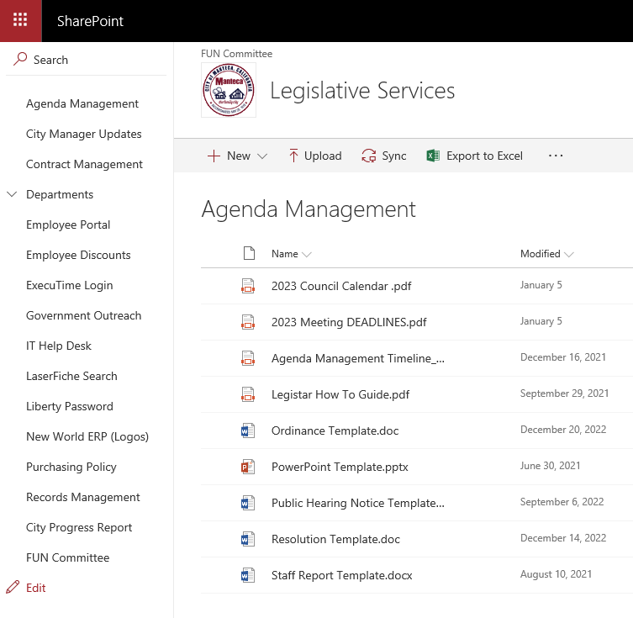
Resources
Intranet
“Agenda Management”
Final staff report examples
Always feel free to
contact us!

Slide 21
THANK YOU!

